Slide 1
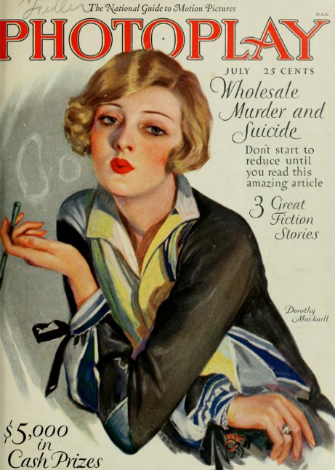
CMN 1160A – Introduction to Media Studies
Week 3B: Media: History, Culture and Politics
Daniel J. Paré
University of Ottawa, Department of Communication
September 22, 2016
Notes:
1

Slide 2
Preview
Renaissance and the Enlightenment
Dawn of the Eye: Born Among Clowns
Notes:
2

Slide 3
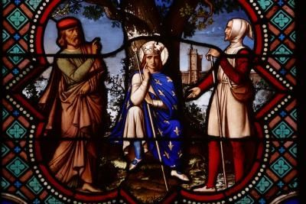
From the Middle Ages to the Renaissance

Slide 4
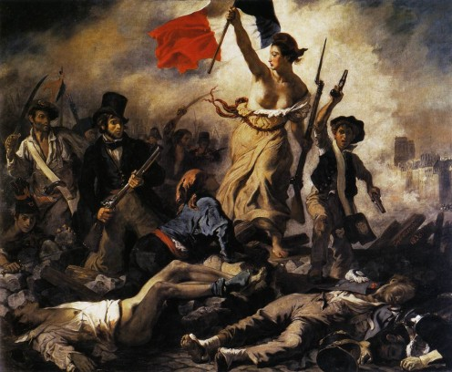
Age of Enlightenment /Age of Reason

Slide 5
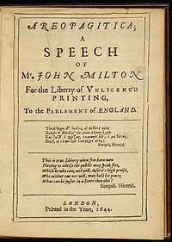

Slide 6
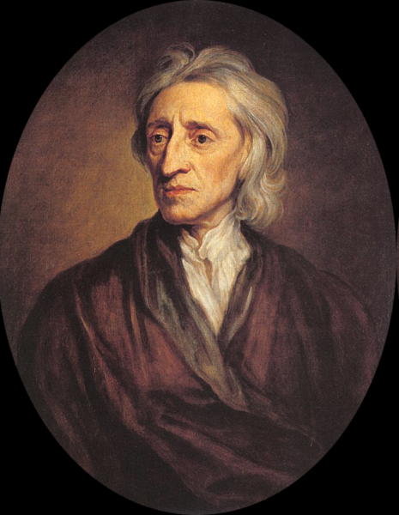
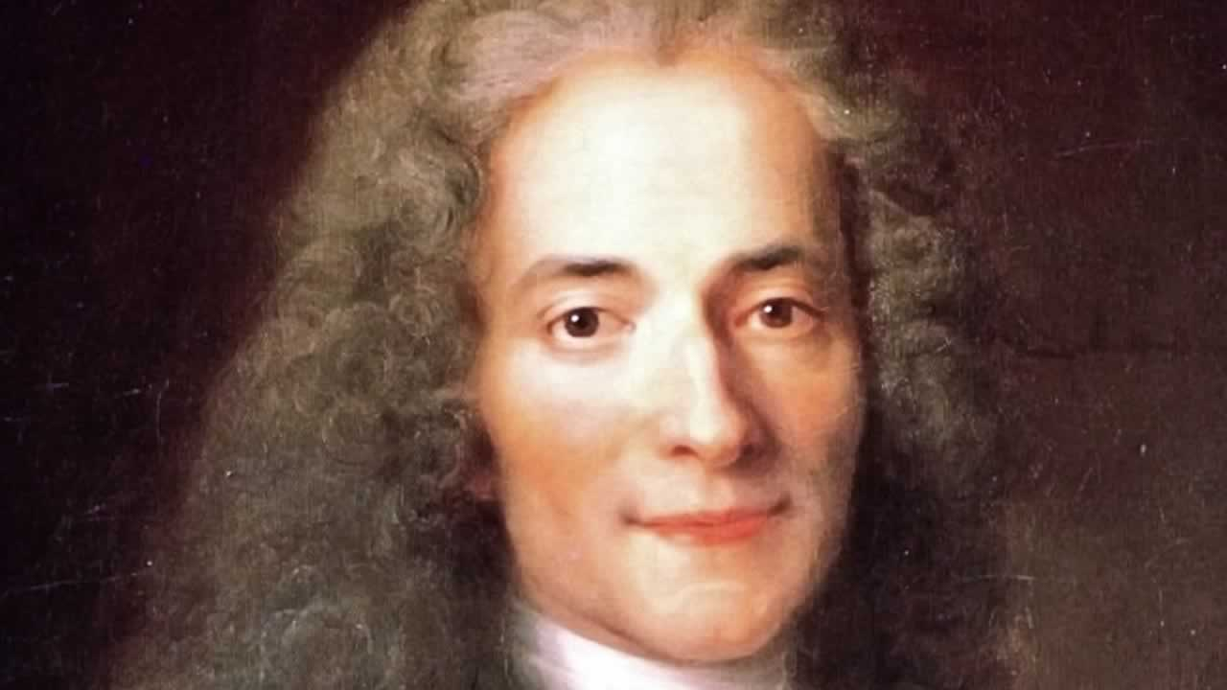
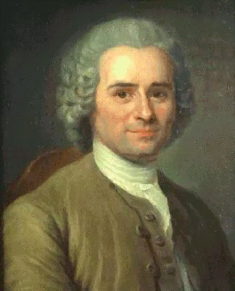
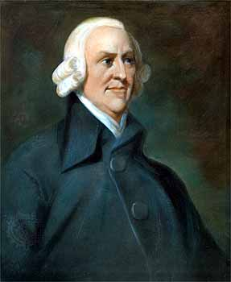

Slide 7
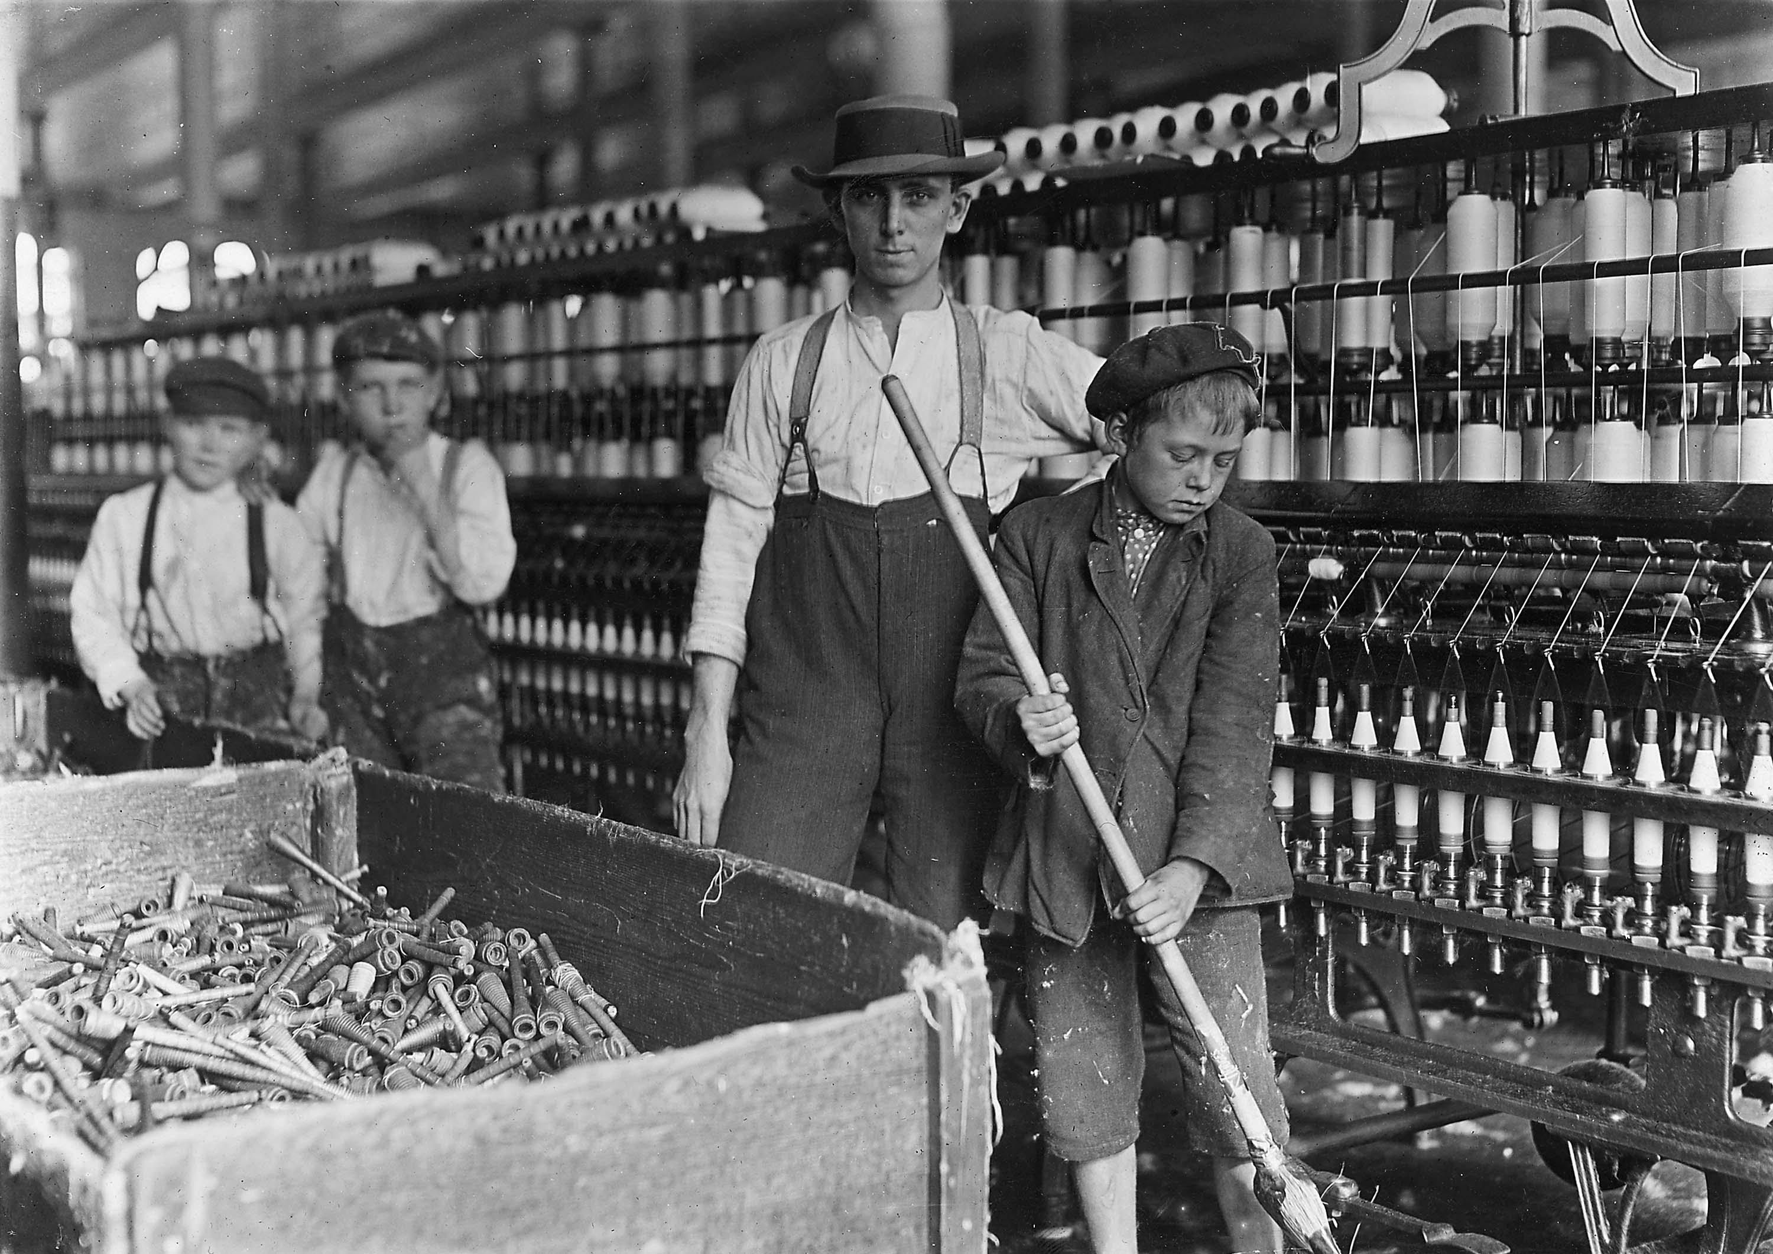
Industrial Revolution

Slide 8
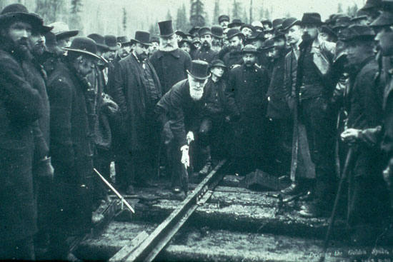
Media and Canadian History

Slide 9
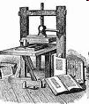
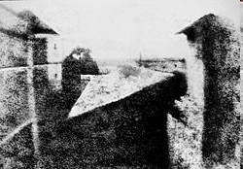
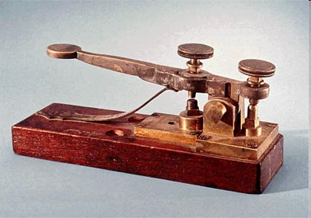
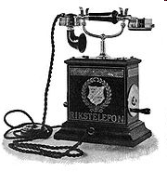
Evolution of modern media/1
1455: Movable-type printing press by Gutenberg
1830s: photography
1838: telegraph;
1844: first line between Washington and Baltimore;
1866: connection between USA and Europe via submarine cable
Post 1830s: emergence of new international agencies
1871: telephone
Notes:
9

Slide 10
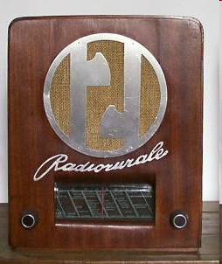

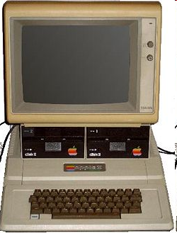
Evolution of modern media/2
1895: radio;
1922: the BBC starts to broadcast from London
1936: television;
1940s: the first computers
1953: colour television
1969: the internet
1972: email and mobile phones (1 Kg!)
1977: first home computers (Apple)
1975: digital photography
1990s: WWW and Mosaic browser
2000s: social networking
Notes:
10

Slide 11
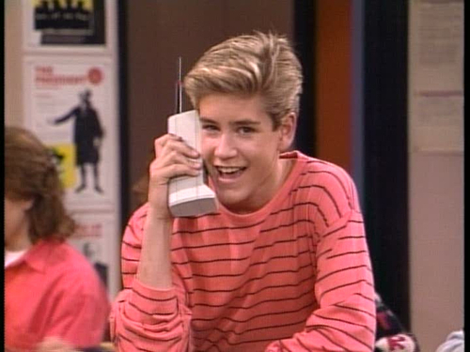
Notes:
11

Slide 12
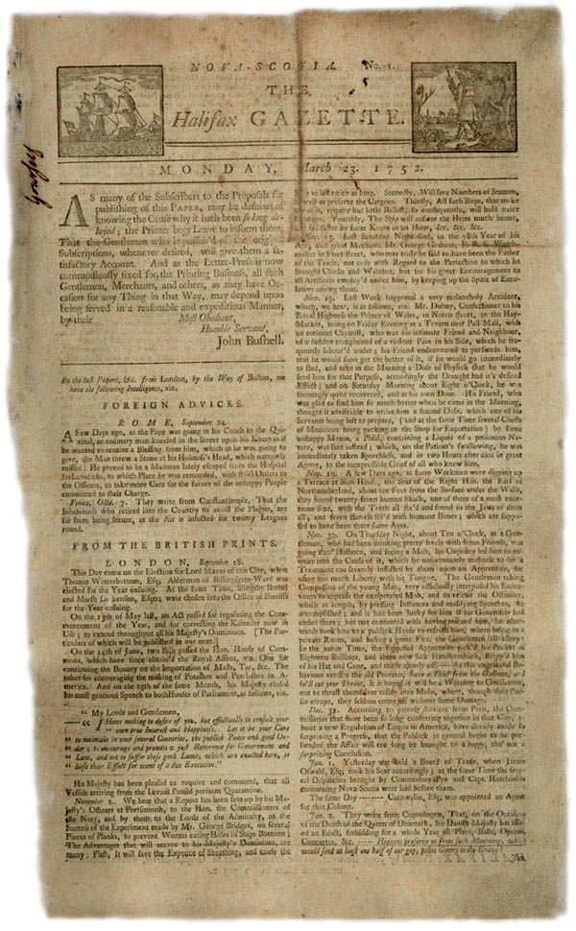
News Media History
Transplant Period (1752-1807)
Growth Period (1807-1858)
Case of Joseph Howe
Westward Growth Period (1858-1900)
Dawn of Yellow Journalism
20th Century onward

